Slide 1
Self-Service BI At Microsoft
Kirkland Barrett
Principal Program Manager
Microsoft IT
kbarrett@microsoft.com
Notes:
Blue - Use for Cloud on Your Terms specific content

Slide 2
Microsoft IT: Where are we headed
EL, iterate, then Production T
Free Market Economics for Data
Social BI
Selfish
Sticky IP
Automated, Community, Certified
Global IP
& Insight
Speed of Data, Speed of Business
Support the Spectrum of Self-Service

Slide 3
Current State
Programs, BI Approach, Business Feedback
Notes:
Blue - Use for Cloud on Your Terms specific content

Slide 4
Today’s EDW Program Landscape
Process Unit
Process Units
Programs
Data / Subject Areas
Programs
Data / Subject Areas
Maintenance | Programs | Total
$304K | $426K | $731K
Maintenance | Programs | Total
$995K | $9.7M | $10.8M
I2A
Product & Services
O2F
Operations
PRSS BI
Elemental Product
Pricing
Bill of Materials
Ops Datamarts, OA 3.0
Inventory
Manufacturing
Work Effort
Fulfillment Delivery
Maint. | Enhance | Programs | Total
$3.9M | $152K | $10.9M | $15M
A2L
Marketing
F2CV
Services & Support
Campaign
Marketing Event
Marketing Communication
Marketing Account
Lead
CPR, SSV, SIR, SAAM, JADE, DIM, PSR, SBIS, MSVoice, CAP Reporting, CCF Reporting, CDM, EXTRA, IFT
Incident
Support Account
Support Activity
Eligibility
Maintenance | Programs | Total
$856K | $3.1M | $4.1M
Maint. | Enhance | Programs | Total
$5.3M | $571K | $19.4M | $26.2M
L2O
Sales
CF
HR, LCA, Finance, IT
Seller Mart
SMS&P CA
EBMS
CVP BI
Sales Account, Partner Account, Opportunity, Sales Activity, Subscription, Sales Revenue
Anti-Piracy Portal, SVEN, MS Cloud, Velocity, MSSales
Mercury, Informa, Alfred
Plancast, OneStatus
Personnel, Workforce, Compensation, Sales Agreement, Legal Agreement, Legal Account, Anti Piracy Enforcement Case, General Ledger, Accounts Payable, Accounts Receivable, Revenue, Account, Expense, Application, IT Program
Platform Services
ETL Services
Data Profiling
Service
Data Quality Service
Monitoring & Logging
Data Integration Service
Presentation Services
Data Publication Services
Grid Computing Services
Security Services
Maintenance | Programs | Total
$4.8M | $3.4M | $9.4M
Notes:
This slide depicts the overall landscape of BI Programs by Process Unit and the evolving platform services that support them.
As we move into FY13 planning we will have to address the load-balancing of budget to ensure Platform Services can meet the demands of the BPUs (historically investment in these services has ranged from 5 to 7% of the total BI budget).

Slide 5
Today’s BI Approach
MSIT Charter
MS DNA
Centralized | Selective | Balanced | Federated | Decentralized
Provides a single point of control and decision making, with limited input from outside IT | Selected decisions and activities are owned by the business | Decisions and activities are jointly shared between IT and the business | The business exert control over decision-making and activities, with limited input from IT | Business users operate with autonomy
Data
Data Management
Reporting & Analytics
Notes:
MS DNA aligns to decentralization
Too expensive and duplicative with multiple SLDCs that do not allow for data sharing across MSIT or departments
BIE’s charter has been aligned to a centralization approach with selective BI
Too expensive and slow with a traditional SLDC that does not include data exploration and trial
Limit scale in terms of all data within Microsoft

Slide 6
Today’s Business Feedback
CHALLENGES
BI in Microsoft reflects the business operating model – historically silo’d, IT has tried to glue it together unsuccessfully
Pervasive need for department and analytical intelligence is going unmet by corporate solutions
Local solutions have proliferated and lack consistency
IT too slow to market
Business to business connections and standardization are low
We need a new approach to BI for breakthrough results
Notes:
On the IA findings from field IT: Need to limit the words to just the bold below, the rest can go in notes. The points I see we need to make are:
The field teams have a need for department and analytical intelligence. Most corporate tools don’t support either, so they do their own.
Field is good at departmental reporting, but local solutions lack consistency and therefore provide a fragmented view to field leadership
Redundancy in field solutions is high, sourcing is an issue (limited corp tools)
Connections being made with SMSG Finance, RoB, Operations….to be expanded to GMO, Corp. Finance and others
Need new IT approach to enable the business going forward
Original Text from IA Findings from the Field work
Not applications -> No IT assistance
Most sub solutions today do not fit the MSIT definition of application, which puts them under the radar of oversight and IT assistance, yet they deliver important functionality and shape user experience with data
No database -> Limited Flexibility
Most of the sub solutions today do not have an underlying database, which limits the ability to deliver the functionality that users identify as gaps
No documentation -> Limited Extensibility
Most of the sub solutions today do not have the necessary documentation to describe what they do, and enable future enhancements; tacit data not meeting MSIT standards
Issues with data sourcing -> Lower data integrity and consistency
Many solutions today use data sources that contain derived data (not from the master source) and making decisions on their own, thus possibly incurring a risk with the integrity of the data they deliver; for sure there is a consistency issue with this approach for the One Truth across the subs
Redundant data flows -> Higher TCO
Core data sources and data sets get redundantly acquired and managed, e.g. MS-Sales revenue is handled 16 times, when in fact it can be acquired for the Field once and used many times
Out of 54 data flows, 34 are redundant
Field Performance Management effort to streamline the Field Subsidiary Scorecard data landscape by at least 80%
Data Simplification thru centralized data acquisition by at least 63%
Data Simplification thru certified sourcing of derived data (e.g. EAF, Toulouse, etc.) – expect additional 17%
Additional benefits include higher information integrity, consistency, agility and improved user experience.
This information was generated by the Field team and presented to the LT this past week regarding the challenges in getting Country managers and the Field data to run their businesses. Our strategy would solve these issues in the following ways:
No IT assistance – with the creation of a Managed Self Service environment, the subs could generate and share information with each other. Once there is momentum and commonality built in to the questions their answering with the Managed Self Service environment, a solution could be productionalized based on priority and overall strategy
Managed Self Service platform solves the following challenges:
Not applications -> No IT assistance – Platform will provide users with an ecosystem where they do not need to wait for IT to build something for them individually
No database -> Limited Flexibility – Platform will be built and maintained by MSIT therefore, all departments do not have to acquire, build and manage their own ecosystems
Issues with data sourcing -> Lower data integrity and consistency – Platform will provide data closer to the source
Redundant data flows -> Higher TCO – Managed Self Service and prioritized implementations slow and ultimately stop the creation of redundant tools to answer the same questions
BI Governance and Data Stewardship driven by the business with IT participating and coordinating solves the following challenges:
No documentation -> Limited Extensibility – Providing guidance, methods and tools enable the growth of common business definitions from data owners that are shared and exploited by many business units. This is a DNA shift that needs to occur and recognize that one of the most important assets Microsoft owns is it’s data, which helps shape the business strategy and drive timely decisions once generated, adopted and maintained at a corporate, segment and field level. This is not a small undertaking, which requires sponsorship, authority and buy in to be successful.
Redundant data flows -> Higher TCO – data stewardship helps drive common understanding of the business definitions that flow through to IT as metadata once solutions are productionalized

Slide 7
Industry & Product Direction
Evolution of BI
Notes:
Blue - Use for Cloud on Your Terms specific content

Slide 8




The world of data is changing
Data
explosion
10x increase every five years
Hadoop
Cheap, Distributed Storage & Processing
85% from new data types
Volume
Velocity
Variety
Easy Accessibility of External Data
Cloud
By 2015, organizations that build a modern information management system will outperform their peers financially by 20 percent.
– Gartner, Mark Beyer, “Information Management in the 21st Century”
Notes:
There is a sea change coming to the world of data. The growing demands of end users (Consumerization of IT) and availability of new types of data (Data explosion) is causing a widening gap between our ability to store vast amounts of data and our ability to get meaningful insight and drive decision making based on the data.
The way we work and our expectations on how we work are changing (Consumerzation of IT)
End users expect the same types of immersive user experiences through their business and productivity applications at work as they are used to getting at home
Today, U.S. adults use an average of 4.3 connected devices every day
And the with social media now mainstream, 27% of companies incorporate social media feedback and input into product/service enhancements
Data growth continues to accelerate at an astonishing rate (Data Explosion)
According to IDC, the total amount of digital information in the world has been growing at 60% CAGR, roughly increasing 10x every 5 years
85% of this new data is coming from new data types e.g. sensors, RFIDs, WebLogs etc.
This data explosion, combined with the fact that the cost of storage has practically gone to zero has landed us in a world where we have the ability to store all this data without having to know what we need the data for
This creates both a challenge for IT (on how to store, scale, manage and govern this data) and huge opportunity for Businesses to get insight from this data and differentiate themselves from the competition.

Slide 9
State of Business Intelligence
Only 28% of potential
BI users have any meaningful access
32% of Excel users are comfortable with using it
for “Advanced Analysis”
e.g., PivotTables
31% of all BI initiatives partially meet or don’t
meet the business goals originally set
– Business Intelligence Purchase Drivers and Adoption Rates, Gartner
– Excel Segmentation Research
– BI Survey 9, BARC
Knowledge workers spend too much time looking for, not enough time analyzing the information.
Lines between producers and consumers of information have largely disappeared.
Requirements change way too fast for IT and traditional technology to keep up.
Half of BI stakeholders do not feel their BI applications are agile and flexible enough¹
By 2014, 85% of the data warehouses currently deployed will fail to scale to meet new information volume and complexity demands²
Only 28% of potential users are using the standard BI platform of choice in organizations³.
Agile BI Out of The Box, Forrester Research, Inc., April 22, 2010

Slide 10





Desired Outcome: Striking a Balance
IT Professional
End-User
      Connect & Provision
      Find & Access
      Monitor & Manage
      Mash-up & Analyze
      Deploy & Future Proof
      Share & Collaborate
Control
Agility
Consistency at the Core
Agility at the Edge

Slide 11
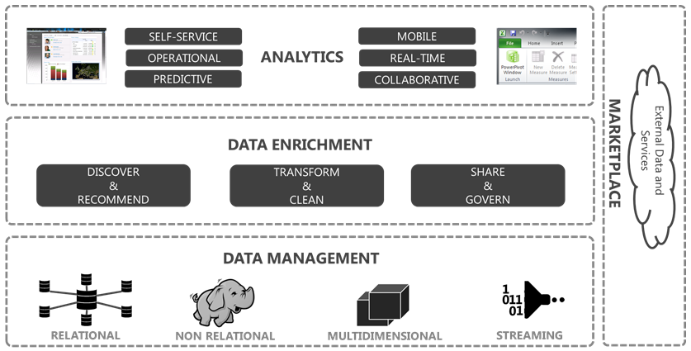
Big Data requires an end-to-end approach
Notes:
SharePoint – BI, Enterprise Search, Enterprise Content Management, Collaboration
Transform - ETL
Clean – Data Quality, Augmentation
Discover – Search, Meta-data, Classification, Information Catalog
Infer – Recommendation Engines, Machine Learning
Share – Publish, Collaborate
Govern – Lineage & Impact Analysis, Master Data Management
Marketplace – Private, Public, Bing Data, 3rd Party Data Sources, Models, Algorithms, APIs

Slide 12



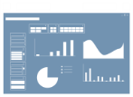












Microsoft Business Intelligence
SharePoint
Search & Dashboards
SharePoint
Scorecards
Excel
Workbooks
PowerPivot &
PowerView Applications
Analysis
Services
Reporting
Services
2012
Integration
Services
Master Data
Services
LOB
Apps
Odata
Feeds

Slide 13
Microsoft Business Intelligence
SharePoint
Search & Dashboards
SharePoint
Scorecards
Excel
Workbooks
PowerPivot &
PowerView Applications
Publish
Discover
Consume
Community
Data Service Layer
Analysis
Services
Reporting
Services
2012
Integration
Services
Master Data
Services
LOB
Apps
Odata
Feeds

Slide 14
Future Objectives
Shifting to a Balanced Approach
Notes:
Blue - Use for Cloud on Your Terms specific content

Slide 15
FUTURE OBJECTIVE
Getting to Real Time IT through a balance of control and agility across Central IT, Federated IT and the Business
MSIT Charter
MS DNA
Centralized | Selective | Balanced | Federated | Decentralized
Provides a single point of control and decision making, with limited input from outside IT | Selected decisions and activities are owned by the business | Decisions and activities are jointly shared between IT and the business | The business exert control over decision-making and activities, with limited input from IT | Business users operate with autonomy
Data
Data Management
Reporting & Analytics
Notes:
MS DNA aligns to decentralization
Too expensive and duplicative with multiple SLDCs that do not allow for data sharing across MSIT or departments
BIE’s charter has been aligned to a centralization approach with selective BI
Too expensive and slow with a traditional SLDC that does not include data exploration and trial
Limit scale in terms of all data within Microsoft

Slide 16













Today’s Model: Traditional ETL
IT Supported
Business
6-9 Months
3-6 Months
Provision
Satisfaction Low
Analysis
Reports
Dashboards & Scorecards
End Users
Transform & Load
Change
$$$
Data
Quality
Analysis
Cubes
Data Warehouse
Specialized Tools
Spreadsheets
Extract
Existing Data
Data Marts
LOB Applications
Data Marts
Files
High cost of rework
IT Pro
New projects move through the traditional BI SDLC to production
IT processes the changes to a hardened solution through the SDLC
Changes are requested to data that’s already in production
After it’s in production, business users get to use the data
Notes:
Key Point: Tell the story of how BI has evolved over the past 10 years and highlight the key challenges IT faces wrt BI tools and deployment today
Slide Storyboard:
If you think about the evolution of BI over the past 10 years, it started out fairly simply with IT primarily aiming to (click)
Consolidate and connect to existing data sources
Stage that data for reporting and analysis(click)
And then provision it out via reports, dashboards or cubes (click)
However, as we saw in the earlier slide that the line between producers and consumers is being blurred, end users in addition to the IT provisioned information, have always wanted more flexibility and agility to do their own analysis and create their own reports. The two most common ways for end users to do this has been to use Excel spreadsheets and a wide array of specialized tools for analysis and reporting. (click)
In creating their own spreadsheet based or specialized tool based BI solutions, end users have effectively found ways to get data directly from various data sources and by-passed the formal IT solutions, making it challenging for IT to control, monitor and manage these BI solutions being used within organizations. (click)
Transition:
So how do you balance the need for end users to have agility in building BI solutions while continuing to provide IT with control and visibility of the solutions being built by end users?

Slide 17



Change the Model: ETL → EL, iterate then T
Governance & Data Stewardship
Common Platform
Managed
Self-Service
Production
Provision
Analysis
Reports
Dashboards & Scorecards
End Users & Business
IT Support
Ad Hoc
Transform
Stable, Defined, Valuable
Data Stewardship
Keep
Kill
Data
Quality
Analysis
Cubes
Data Warehouse
Pilot
Specialized Tools
Requirements
Extract & Load
Spreadsheets
Iterate
Transform
POC
Existing Data
LOB Applications
Data Marts
Files
Experiment
IT Pro / IT Supported
IT provides the platform to extract & load data for immediate use
The business can iterate on the data, getting a better understanding
The business may decide to keep the solution or kill it
Or choose to invest in support for valuable & stable data that has stewardship
IT moves the stabilized transformations into Production for support & scale
All of this should be on a common platform provided by IT
Notes:
Key Point: Tell the story of how BI has evolved over the past 10 years and highlight the key challenges IT faces wrt BI tools and deployment today
Slide Storyboard:
If you think about the evolution of BI over the past 10 years, it started out fairly simply with IT primarily aiming to (click)
Consolidate and connect to existing data sources
Stage that data for reporting and analysis(click)
And then provision it out via reports, dashboards or cubes (click)
However, as we saw in the earlier slide that the line between producers and consumers is being blurred, end users in addition to the IT provisioned information, have always wanted more flexibility and agility to do their own analysis and create their own reports. The two most common ways for end users to do this has been to use Excel spreadsheets and a wide array of specialized tools for analysis and reporting. (click)
In creating their own spreadsheet based or specialized tool based BI solutions, end users have effectively found ways to get data directly from various data sources and by-passed the formal IT solutions, making it challenging for IT to control, monitor and manage these BI solutions being used within organizations. (click)
Transition:
So how do you balance the need for end users to have agility in building BI solutions while continuing to provide IT with control and visibility of the solutions being built by end users?

Slide 18


Striking the Right Balance
Finance
Control
Agility

Slide 19


Striking the Right Balance
Spectrum of control & agility
One size does not fit all
Each business defines their spectrum
By industry, segment, function, or market maturity
May change over time
Misaligned results in higher costs, inefficiencies, & missed value
Requires an end-to-end platform
Sales & Marketing
Control
Agility

Slide 20
BI Delivery Channels
Scale, security, support, control, operate
Insight, SME knowledge, opportunity, speed of business
Central IT
Federated IT
Business
Control
Agility

Slide 21
Where we are headed
Embracing Self-Service
Notes:
Blue - Use for Cloud on Your Terms specific content

Slide 22






BI Personas: An Assembly Line
Decision Maker
BILL
VICKI
Decision Support & Reporting
domain view of business activity holistic
STEWART
ANNA
Application Development
ELTON
BEN
simple interaction with information systems complex

Slide 23
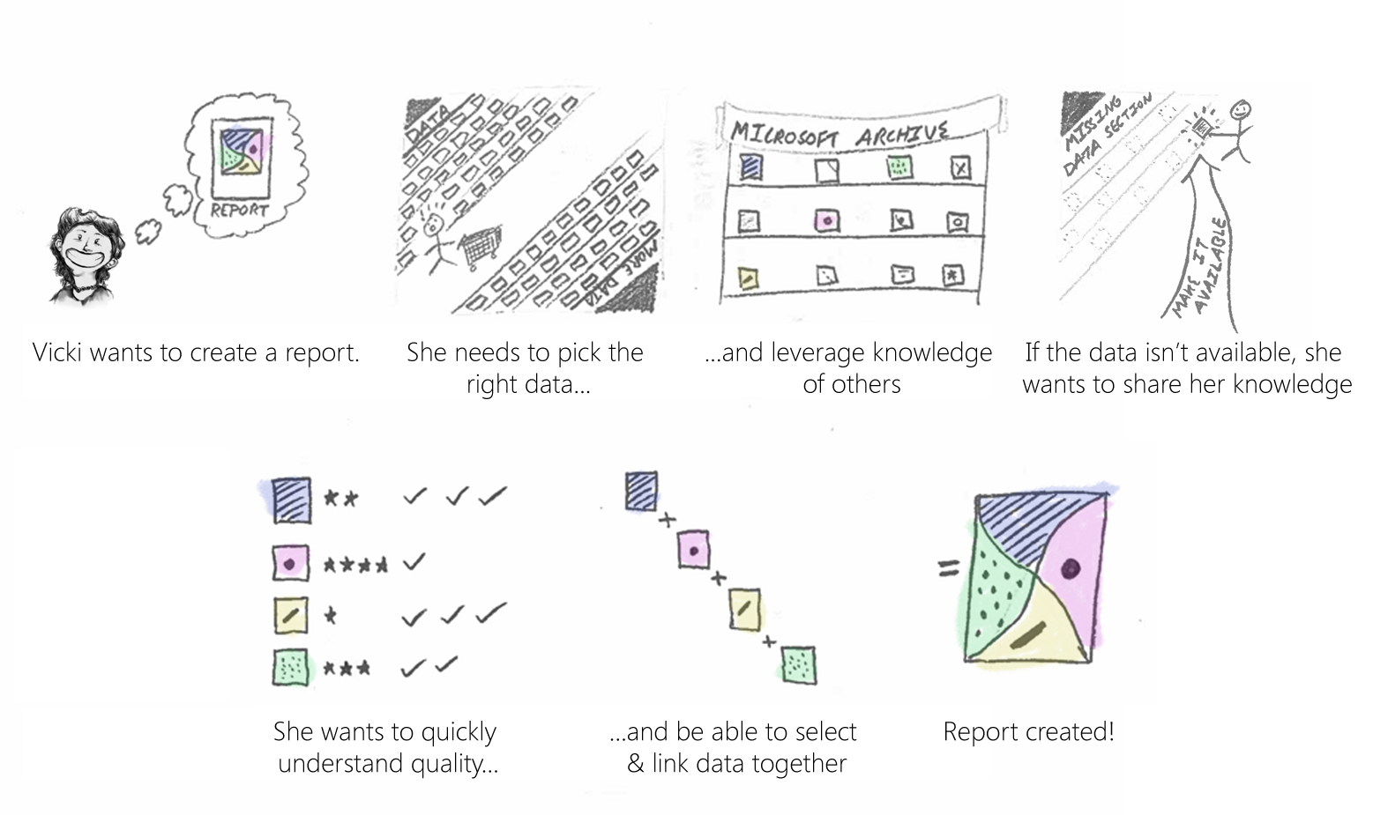
Vicki Scenario
Notes:
If data isn’t available, she wants to share her data

Slide 24
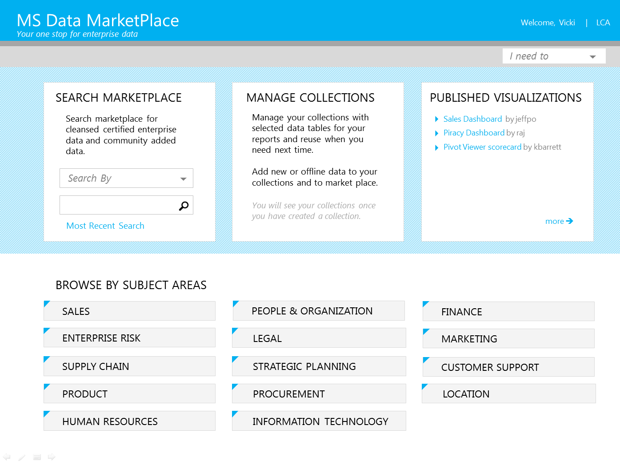

Slide 25
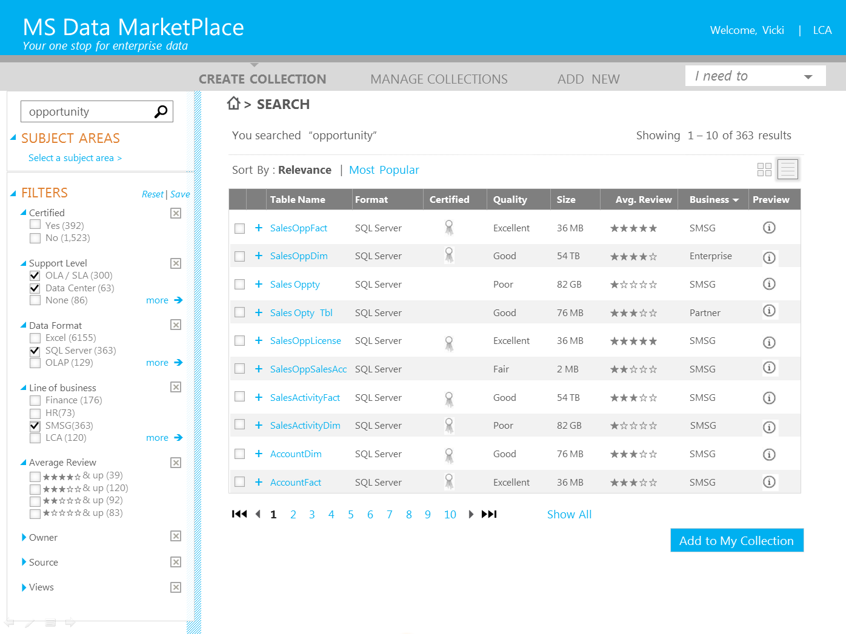

Slide 26
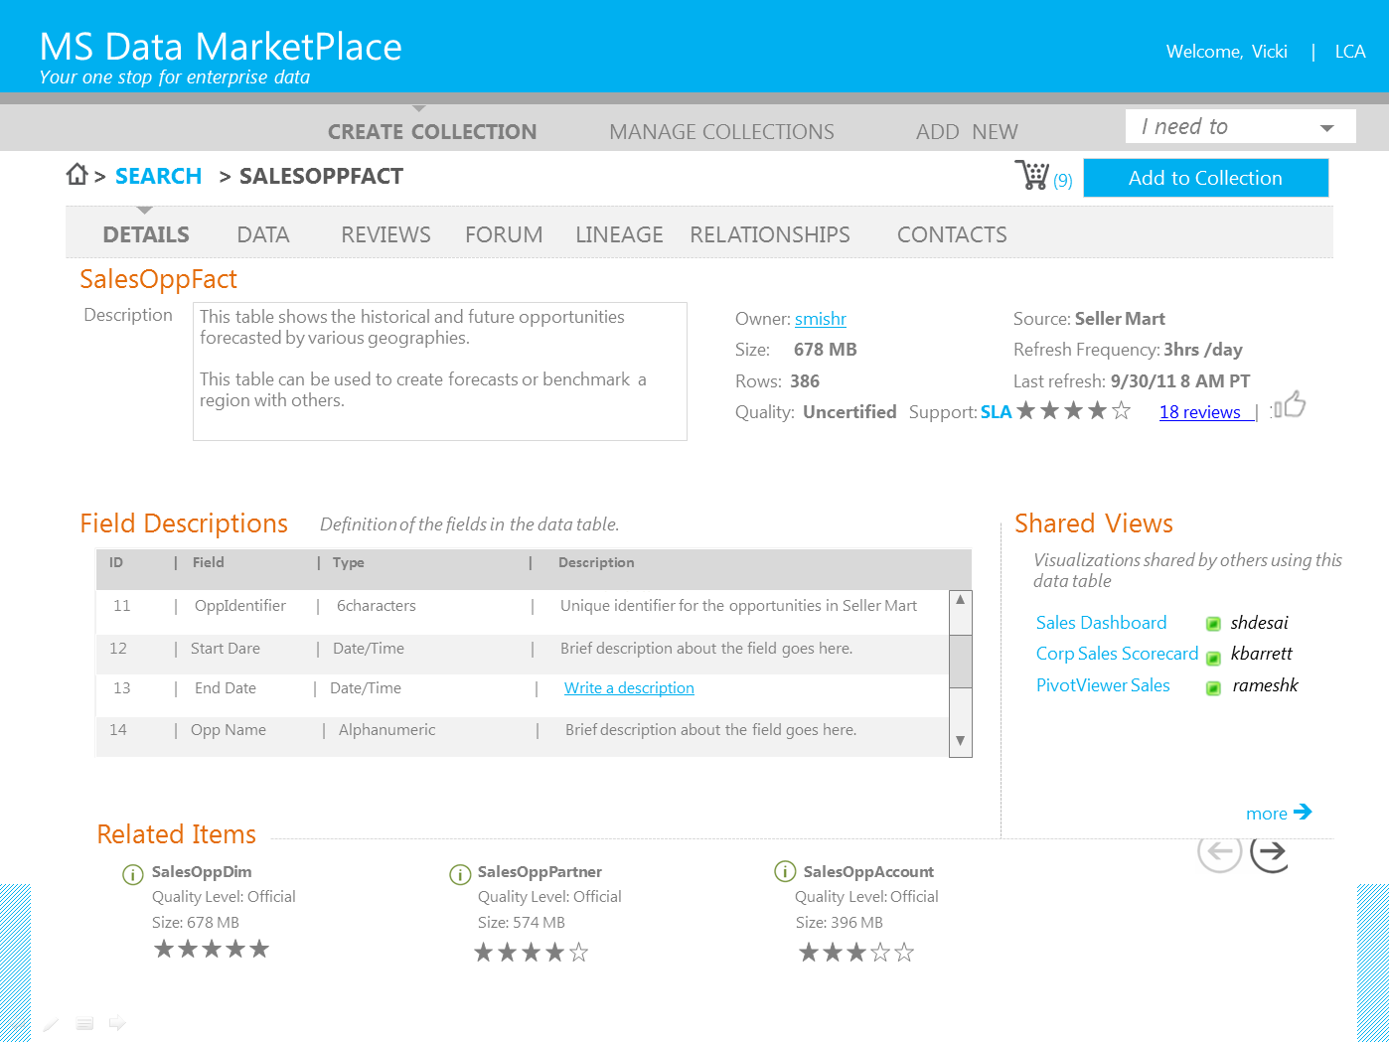

Slide 27
Microsoft IT: Where are we headed
EL, iterate, then Production T
Free Market Economics for Data
Social BI
Selfish
Sticky IP
Automated, Community, Certified
Global IP
& Insight
Speed of Data, Speed of Business
Support the Spectrum of Self-Service

Slide 28
Q&A
Notes:
Blue - Use for Cloud on Your Terms specific content

Slide 35
Notes:
Blue - Use for Cloud on Your Terms specific content

Slide 36
Notes:
Green - Use for Mission Critical Confidence specific content

Slide 37
Notes:
Orange - Use for Breakthrough Insight specific content

Slide 41
Notes:
Blue - Use for Cloud on Your Terms specific content

Slide 42
Notes:
Green - Use for Mission Critical Confidence specific content

Slide 43
Notes:
Orange - Use for Breakthrough Insight specific content

